Slide 1





Slide 2




Slide 3


Slide 4


Slide 5
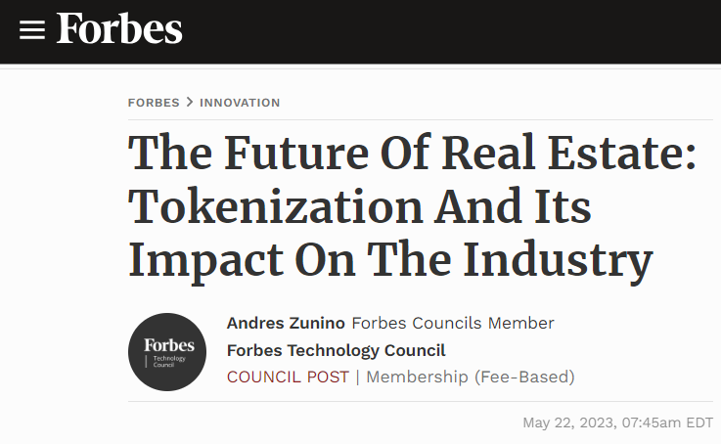
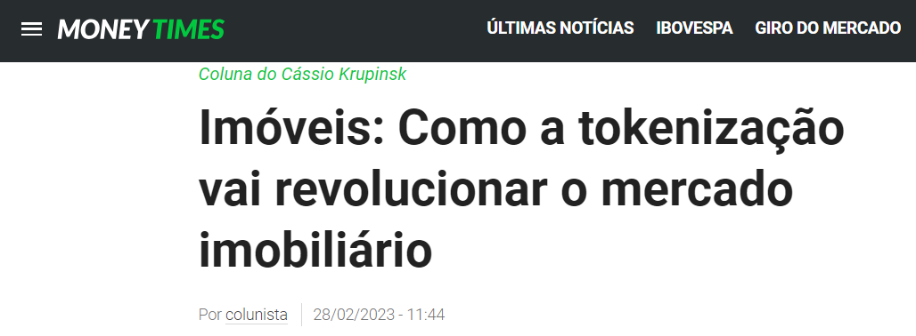
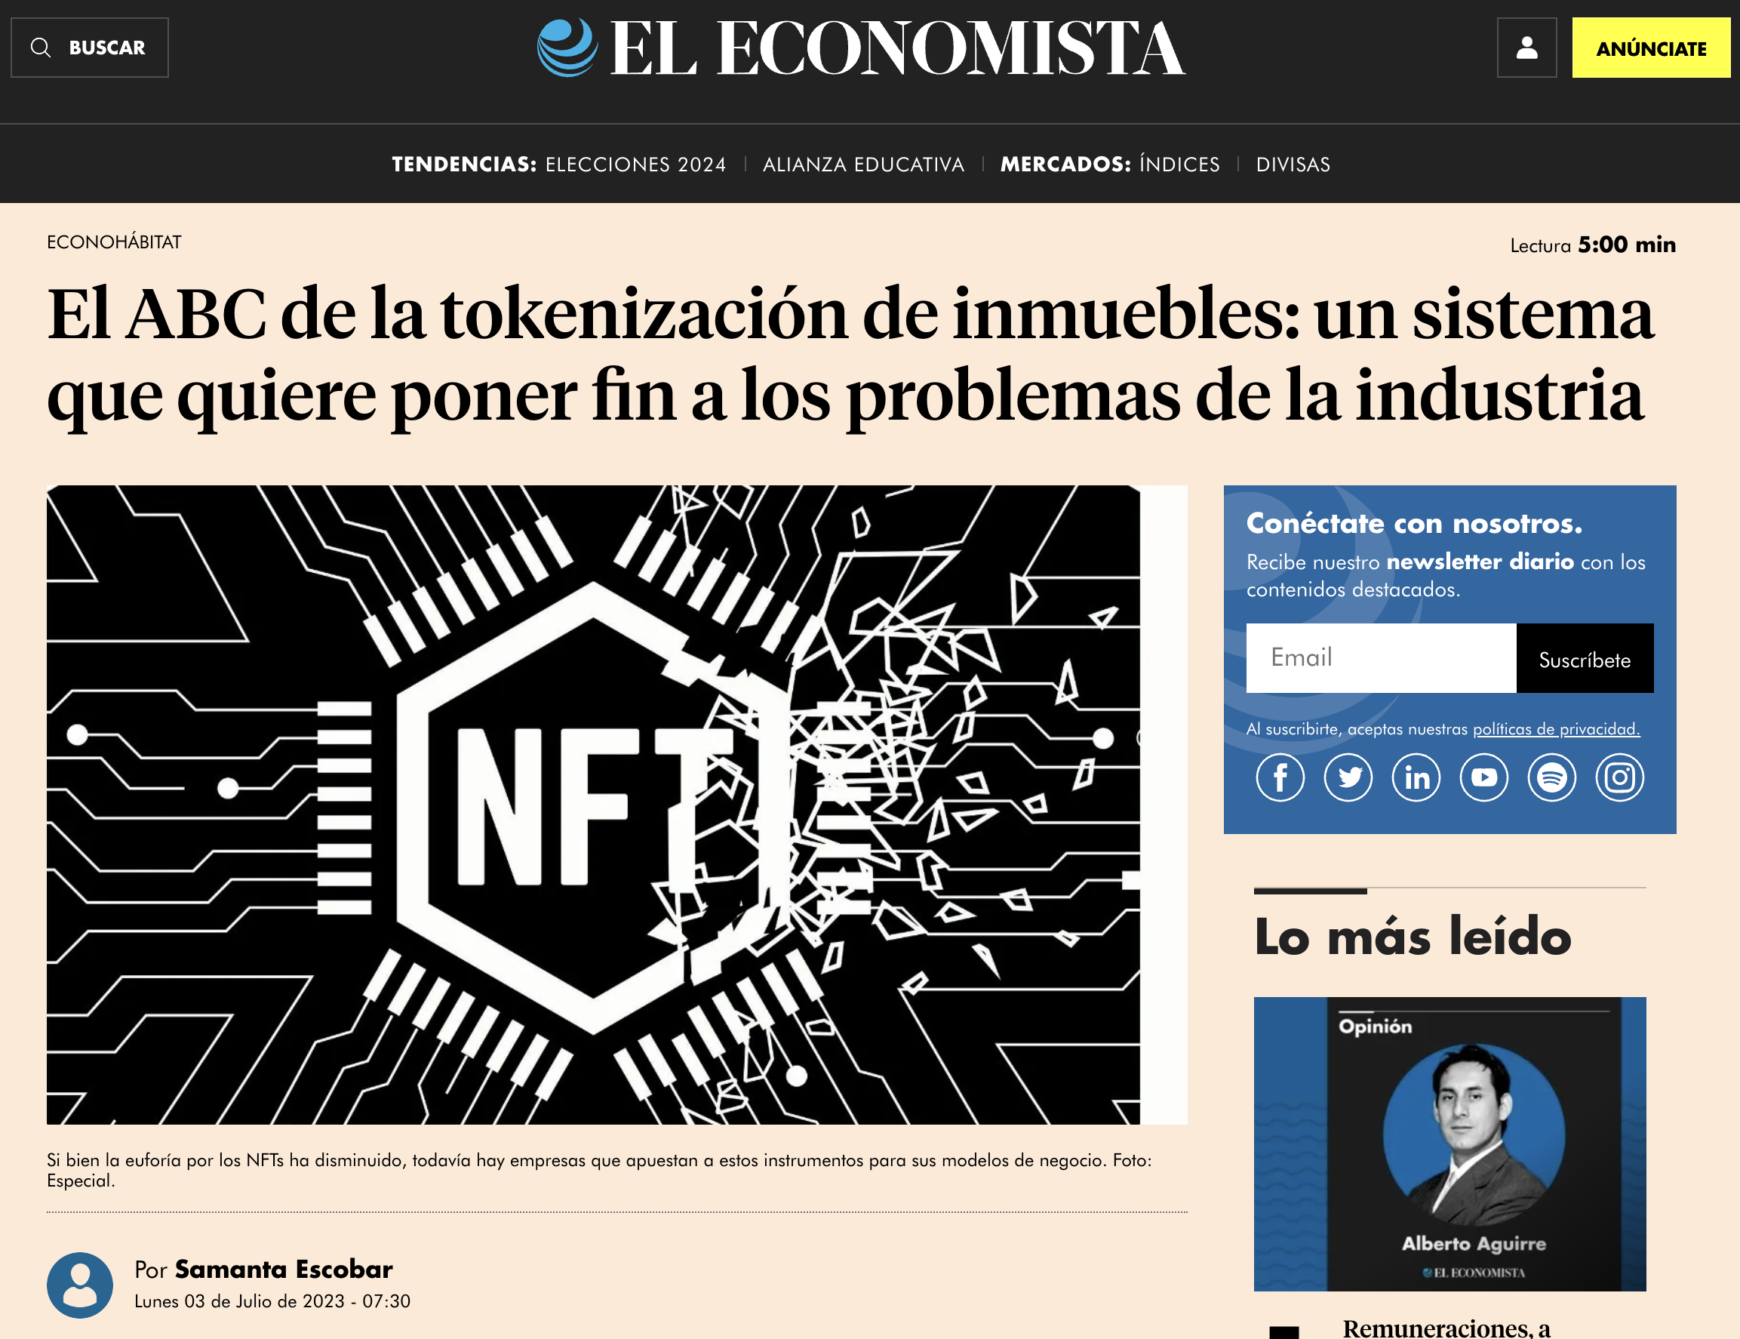
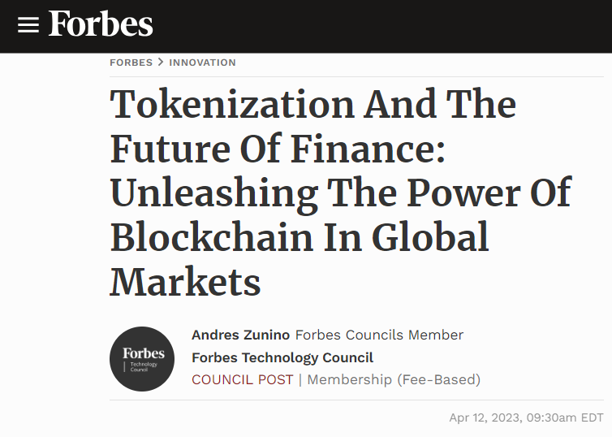

Slide 6



Slide 7

Notes:
WeBid is a safe and easy platform to help you trade your tokenized assets.
- You could auction a token representing a fraction of your appartament.
- You could trade your financial token assets.
- Or maybe you can rent your tokenized appartament.

Slide 9
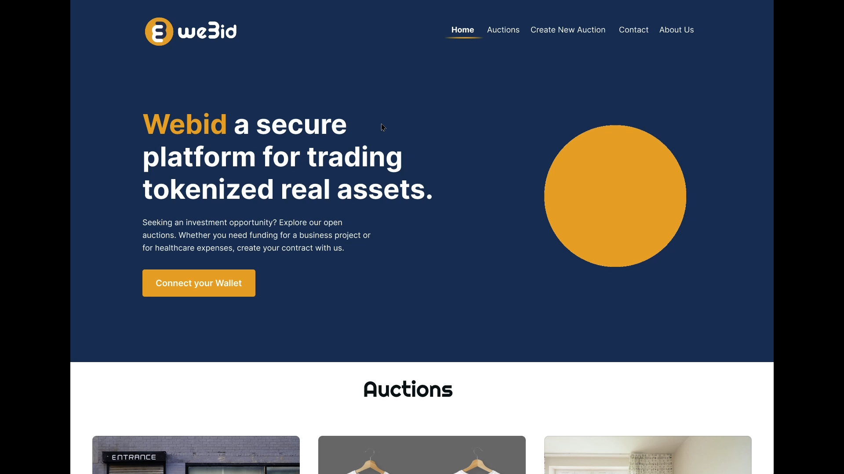

Slide 10
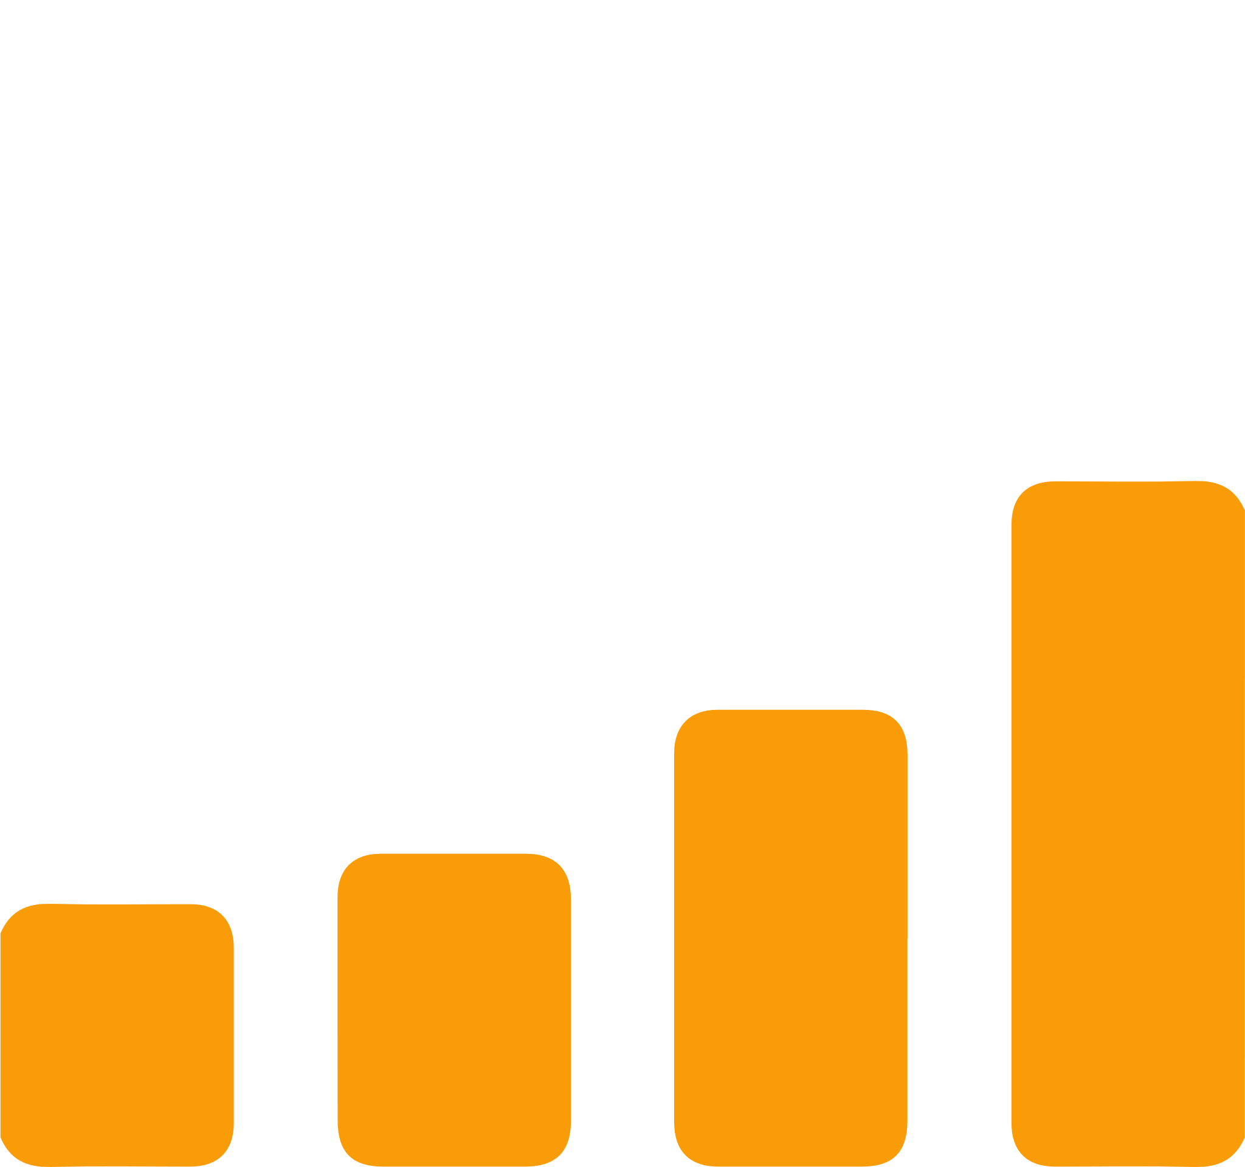
$ 16 trillion by 2030

Slide 11
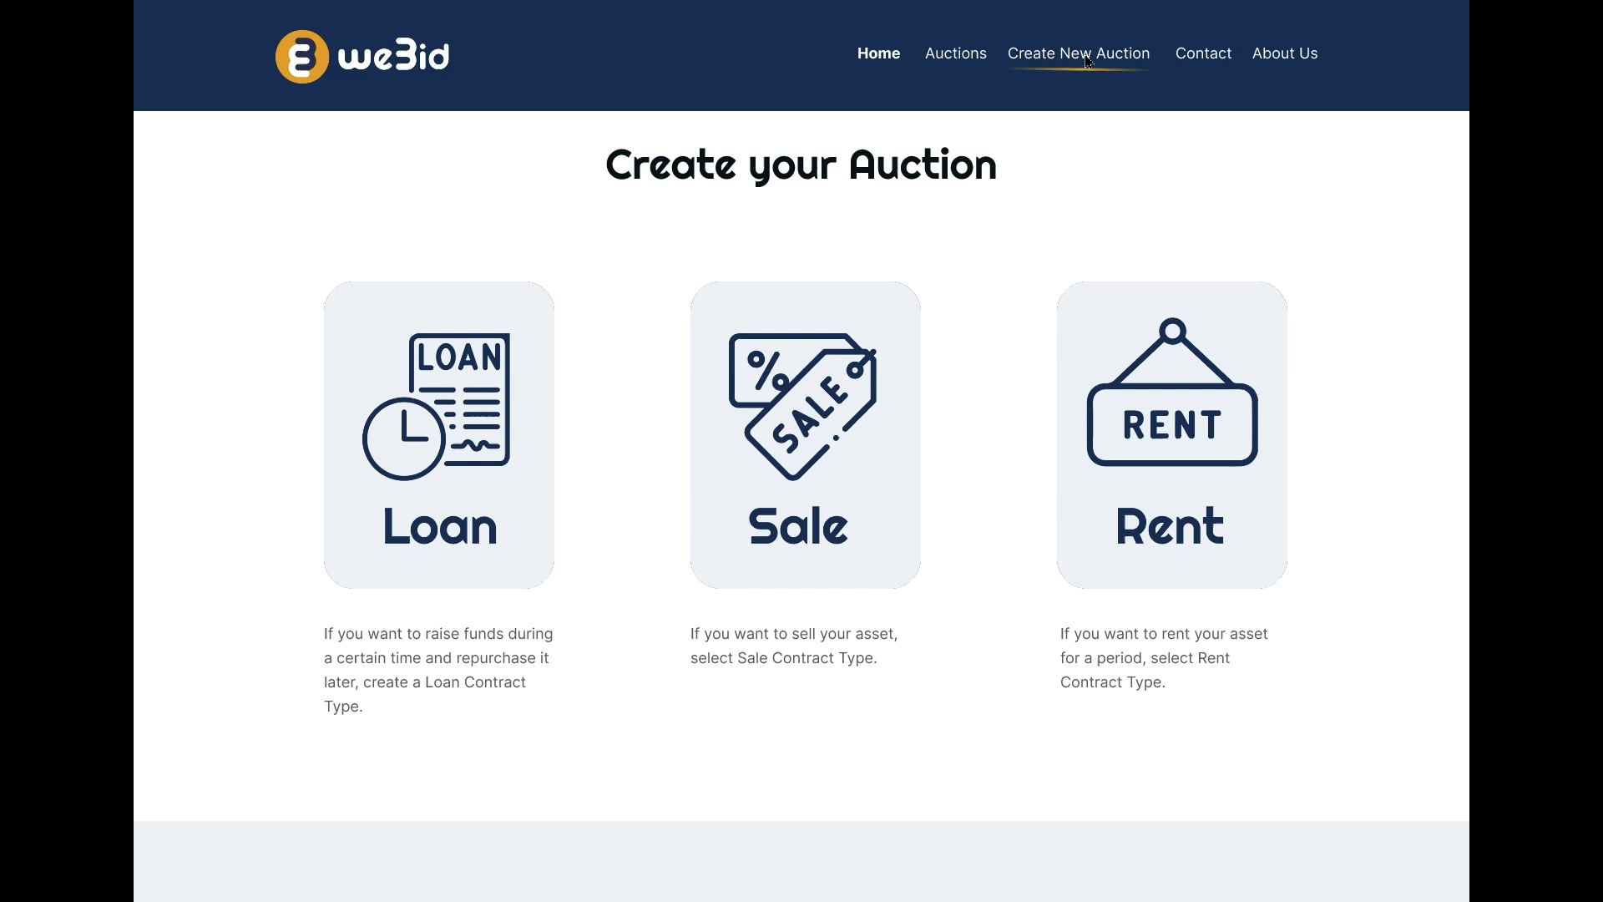

Slide 12
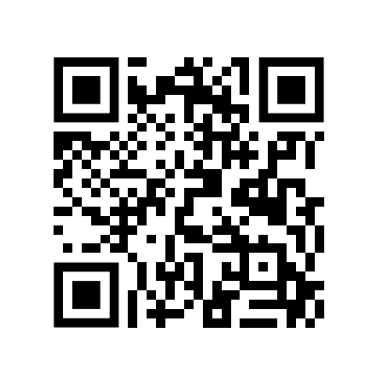
Notes:
Now we will run a small demo of our MVP.
Since we don`t have yet a apartment in Copabacana, will be doing the auction of this awesome t-shirt.

Slide 13
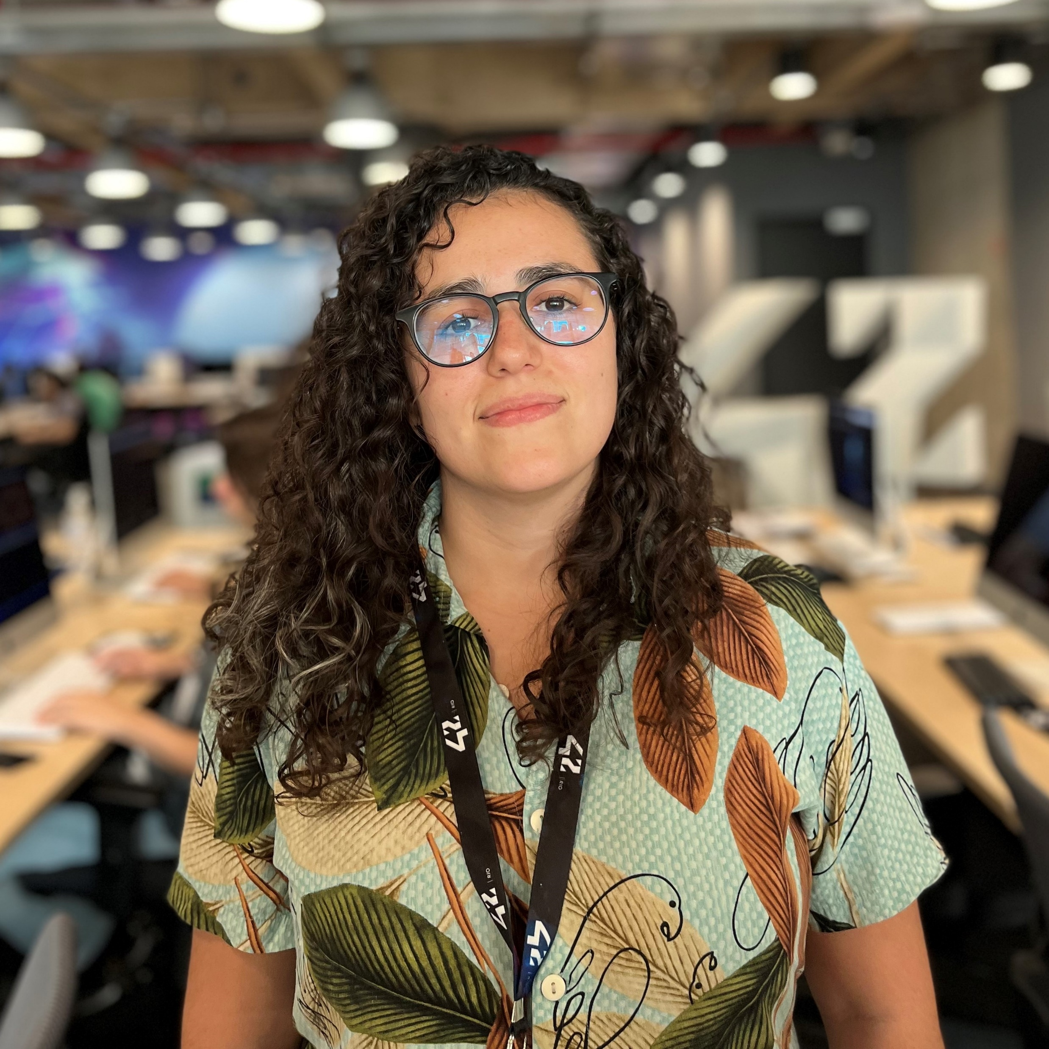

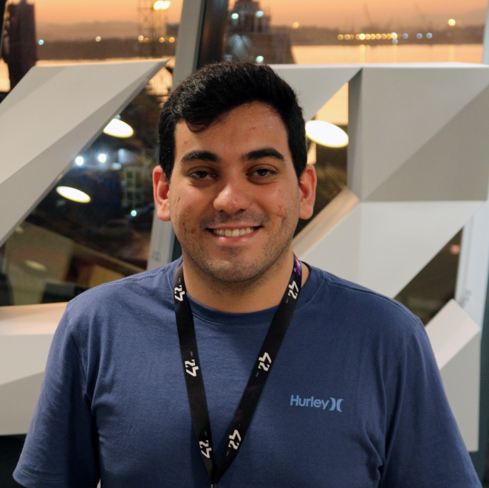

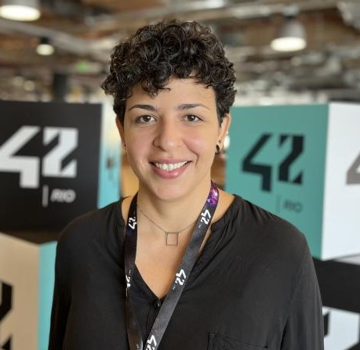

Fernanda Caetano
Pedro Arnaldo
Rafael Verly
Izabele Soares
Pedro Psydenstricker

Slide 14


Notes:
Now we will run a small demo of our MVP.
Since we don`t have yet a apartment in Copabacana, will be doing the auction of this awesome t-shirt.

Slide 15

Notes:
Now we will run a small demo of our MVP.
Since we don`t have yet a apartment in Copabacana, will be doing the auction of this awesome t-shirt.

